Slide 1
Youngstown State University February HCAC Meeting
February 17, 2022
Presented by: Stephanie Mueller – Account Executive

Slide 2
Agenda
COVID-19 Reporting
OTC COVID-19 Tests

Slide 3
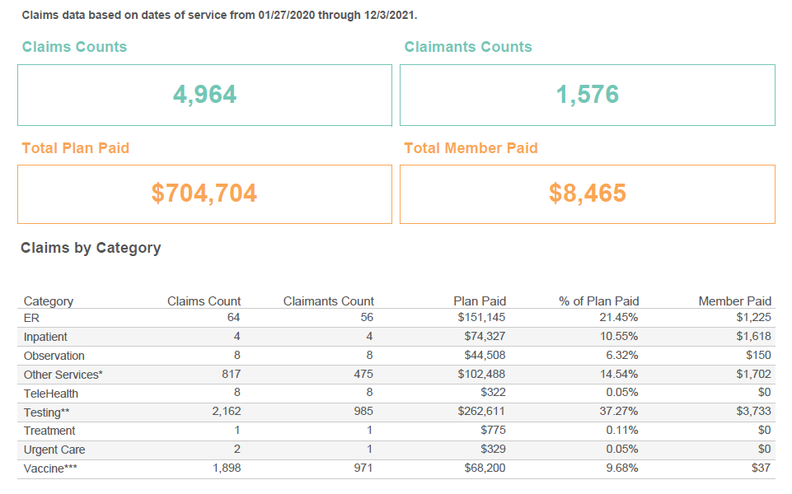
COVID-19 Reporting
Notes:
Data provide on this report is from 1/27/20 through 12/03/21
*Claims in the Other Services Category include outpatient and professional claims not defined elsewhere (i.e. lab tests, clinic visits, radiology,
office/home/SNF/hospital physician visits, claims with a Covid-19 procedure modifier, etc.).
**Claims in Testing category may include costs associated with other services submitted on the same claim.
***Information provided by PBM.
Claimant counts by Category and by Claim Type are not unique. A member may be counted under multiple Categories/Claim types.
Data presented in this report is based on paid claims with Covid-19 specific or related diagnosis and procedure codes. It includes ICD-10 diagnosis
codes [A41.89, B34.2, B34.9, B97.21, B97.29, J12.81, J12.89, J20.8, J22, J80, J98.01, J98.8, R06.89, U07.1, Z03.818, Z11.59, Z20.828],
CPT/HCPCS and/or procedure codes [C9803, G2023 through G2025, U0001 through U0004, 87635, 86328, 86769, 99421 through 99423, 99441
through 99443, 99453 through 99454, 98966 through 98968, 87426, 0202U, 0223U, 0224U] and or CPT/HCPCS procedure code modifier of CS. This
report identifies the Covid-19 related diags listed above regardless of position in the claim (i.e. primary diag vs. secondary diag, etc.). Additional criteria
to validate Covid-19 status and clinical necessity is applied at the time of claim adjudication to determine level of plan payment and member cost
share.
The information displayed is current through the report production date and is subject to change based on CMS, CDC, and industry guidance and
regulations. Previously reported data may change due to adjustments on revised coding and updates where applicable.

Slide 4
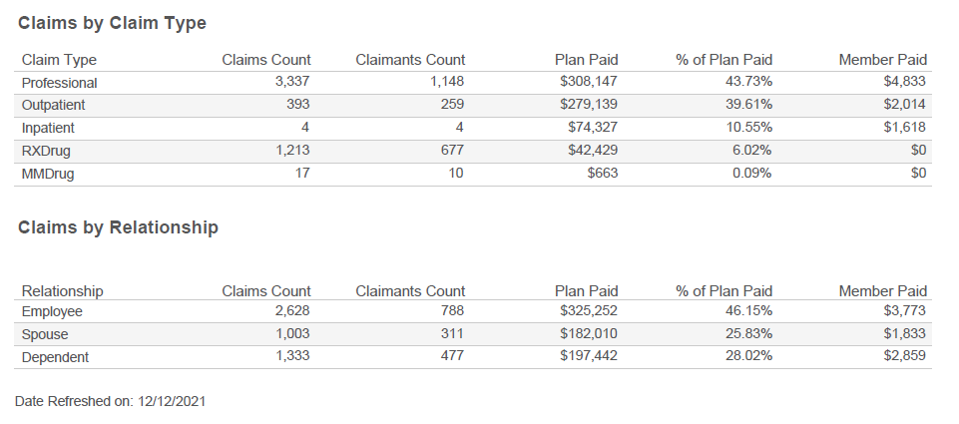
COVID-19 Reporting

Slide 5
COVID-19 Reporting
Notes:
Top 10 facilities
Top 10 facilities – 58.46% of claims paid
Total claimants 212 for 319 claims. Plan paid $240,039 with member paid of $974

Slide 6
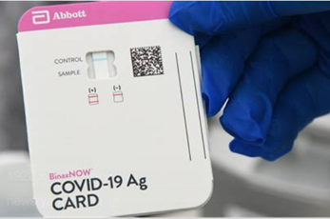
OTC COVID-19 Tests
Effective January 15, 2022
Health Insurers and Employer Groups required to cover FDA-approved/authorized OTC COVID-19 tests with no member cost share
Two Options for Self-Funded Employers
Notes:
Option One – Coverage Under Medical
Coverage
Regardless of if a group has prescription drug coverage with Medical Mutual or through an outside PBM, the group can choose to cover OTC COVID-19 tests under their medical benefits administered by Medical Mutual
Cost to Member
Member pays for test upfront and must submit a claim form, original store receipt and UPC codes from the test boxes to be reimbursed the cost of the test
Cost to Group
For self-funded groups, no additional administrative fees or stop loss premiums apply; cost of OTC COVID-19 tests billed as claims on weekly or monthly invoices.
Reimbursed to cost of the test; no safe harbor applies
Option Two – Coverage under Medical Mutual/ESI Pharmacy
Coverage
If a group has prescription drug coverage carved in, they may choose to have coverage under their pharmacy benefits administered by ESI
Allows members to purchase FDA approved/authorized OTC COVID-19 tests at network pharmacies with no upfront costs
As with other pharmacy claims processed as prescriptions, the FDA-approved/authorized OTC COVID-19 test claims will appear on a group’s pharmacy invoice
Cost to Member
$0 cost sharing for the member when in-network, or reimbursement up to $12 for out-of-network purchases regardless of what the member paid out-of-pocket
Cost to Group
Medical Mutual does not charge an administrative fee for this network
Existing pharmacy dispensing fees for claims apply (ranging from $0.20 - $0.75 per test kit), as does sales tax
$12 per test safe harbor cost would apply

Slide 7
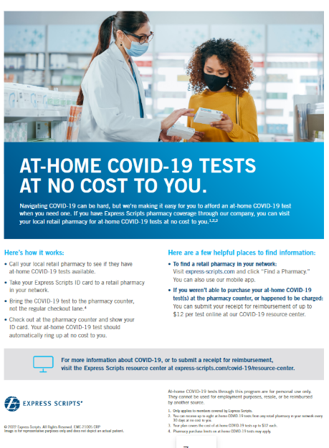
OTC COVID-19 Tests – cont’d
YSU chose Coverage under Medical Mutual/ESI Pharmacy
OTC Test Facts
Reimbursement available for test kits bought on or after 01/15/22
Tests used for surveillance, travel or employment testing are NOT covered (see FDA site for approved tests)
Purchase up to 8 tests per COVERED member per month
If tests are purchased with HSA or FSA you cannot submit for reimbursement
Tests must have the applicable FDA authorization, clearance or approval
FDA maintains a list of tests that are covered:
https://www.fda.gov/medical-devices/coronavirus-disease-2019-covid-19-emergency-use-authorizations-medical-devices/in-vitro-diagnostics-euas-antigen-diagnostic-tests-sars-cov-2

Slide 8
OTC COVID-19 Tests – cont’d
Members can submit a claim through ESI for OTC Covid tests purchased prior to the ESI benefit being coded for a reimbursement up to $12 per test, plus dispensing fees and taxes if provided
Submission Process
Log-in to express-scripts.com and submit electronically
COVID-19 OTC Test Kits should be submitted under single-ingredient drug
If pharmacy receipt is not provided, a standard cashier receipt with COVID-19 OTC Test Kit UPC can be used
NDC
Rx or Prescription number –member may enter a default Rx number ‘11111’•Quantity = 1 ; Days Supply = 30
Date –purchase date of COVID-19 OTC Test Kits
Cost –include cost of kits as shown on receipt
Upload receipt
Review and Submit
Notes:
~ The Claim form has to accurately reflect total cost of tests including taxes and dispensing fees
~ ESI Presentation on claims submission will be provided to Stacey along with the member flier

Slide 9
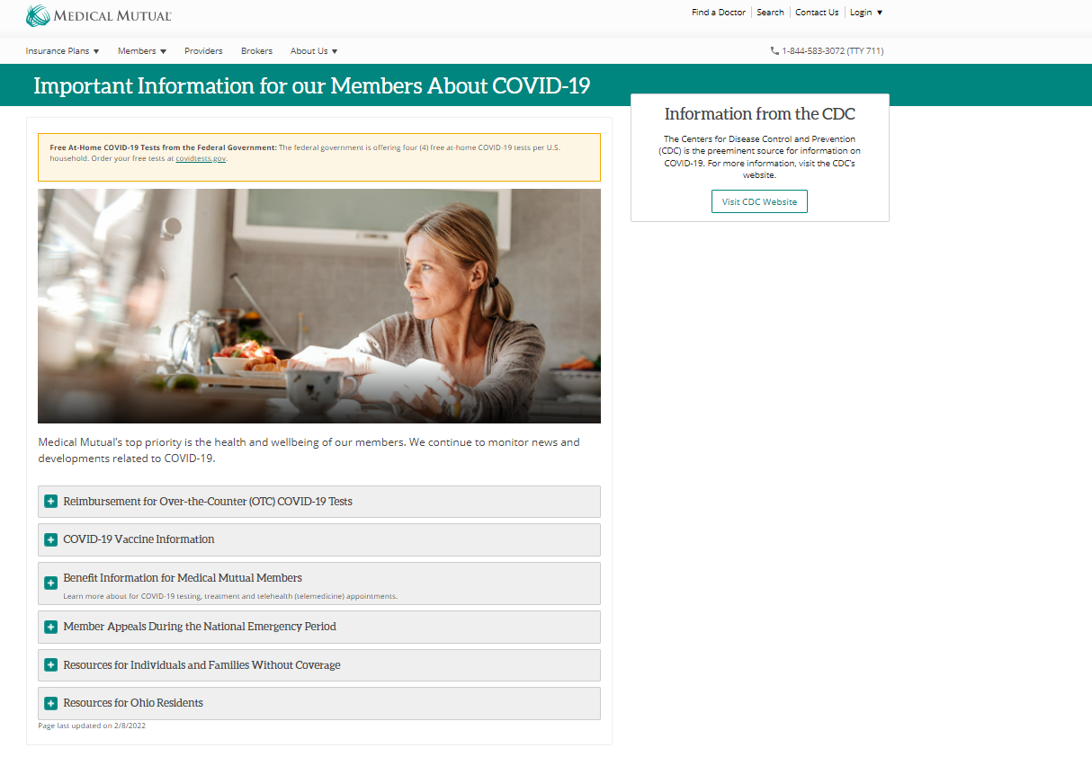
OTC COVID-19 Tests – cont’d
Additional Resources & Information
www.MedMutual.com/coronavirus
Federal government is offering four (4) free at-home COVID tests per U.S. household. Order at: https://www.covidtests.gov/

Slide 10
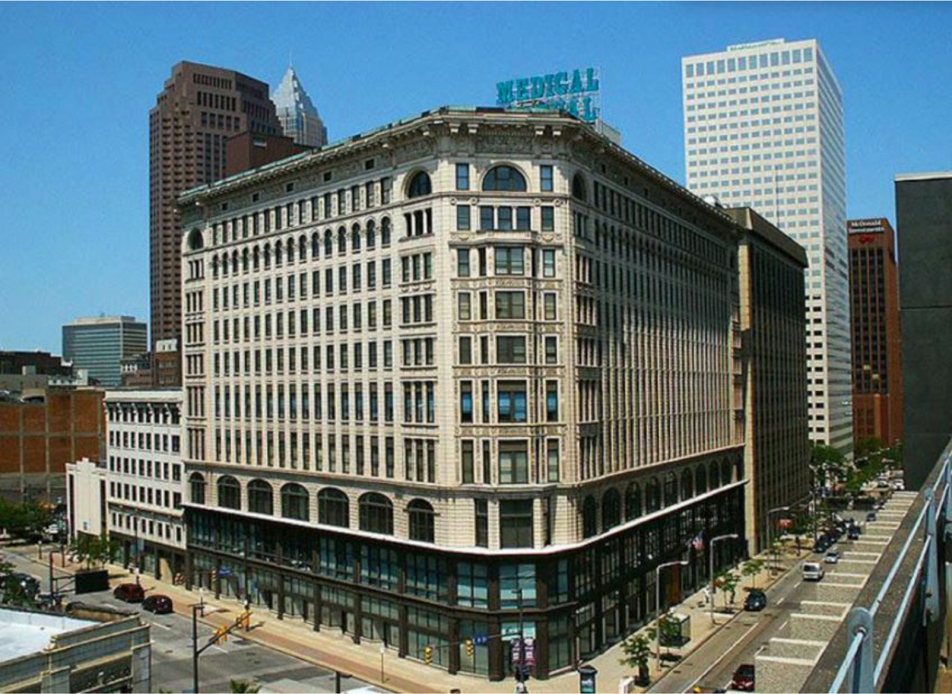
Thank You

