Slide 1
T is for Transparency
Intro and Tips for the TEACH Principles

Slide 2
What are the TEACH Principles?
Developed by the Senate Teaching and Learning Committee
Academic Senate endorsed spring 2022
"Principles of Good Practice in Teaching"
Based in:
Need for a better "definition" of good teaching
Literature around best practices

Slide 3
TEACH
TRANSPARENT│EVIDENCE-BASED │ ASPIRATIONAL │ COMMUNICATIVE │ HUMANE
ysu.edu/TEACH

Slide 4
Transparent Teaching
Example: Write a 5-page paper taking a position on the last reading’s central controversy
About making the invisible, visible
Exposing the “hidden curriculum” and “hidden structures” of college for ALL students
Take notes on the reading
Relate the reading to lecture and class discussion
Consider the reading in relation to previous course material
Use standard written English
Be knowledgeable about instructor’s style guide preference
Know which points the instructor wants you to focus on
The paper will be graded on your ability to explore the topic, not repeat back what the reading says
Notes:
Hidden Curriculum: the concept was first used by Phillip Jackson in 1968 in his “Life in Classrooms”. The hidden curriculum is not formal and is not explicitly stated. It has hidden messages that include the norms and values that enable students to adapt to society and prepare them for the future. Students succeed if they comply with these norms and values or they fail if they oppose them.

Slide 5
Transparent Teaching
About making the invisible, visible
Exposing the “hidden curriculum” and “hidden structures” of college for ALL students
What are some other examples of the hidden curriculum for students?
Notes:
Hidden Curriculum: the concept was first used by Phillip Jackson in 1968 in his “Life in Classrooms”. The hidden curriculum is not formal and is not explicitly stated. It has hidden messages that include the norms and values that enable students to adapt to society and prepare them for the future. Students succeed if they comply with these norms and values or they fail if they oppose them.

Slide 6
Transparent Teaching Characteristics
Provides and follows the course syllabus
Clearly defines grading and attendance policies
Posts syllabus and grades
Offers a clear and organized course structure (calendar, consistent expectations)
Sets expectations for returning student work
Connects course activities and learning goals
Explains what success looks like (e.g., gives examples, rubrics)

Slide 7
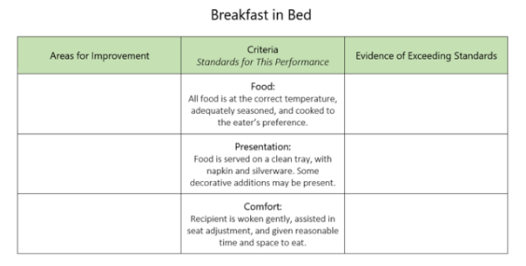
Transparent Tip: Single-Point Rubrics
Easy way to communicate expectations and how you will weigh them (e.g., how important are ideas vs grammar)
Using your prompt to develop a rubric can ensure your instructions are clear
Less onerous than an analytical rubric
Speeds up grading—only commenting on above/below expectations
From cultofpedagogy.com

Slide 8
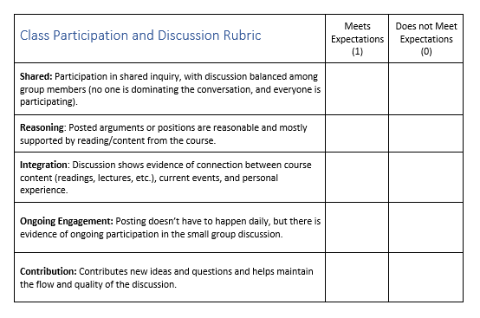
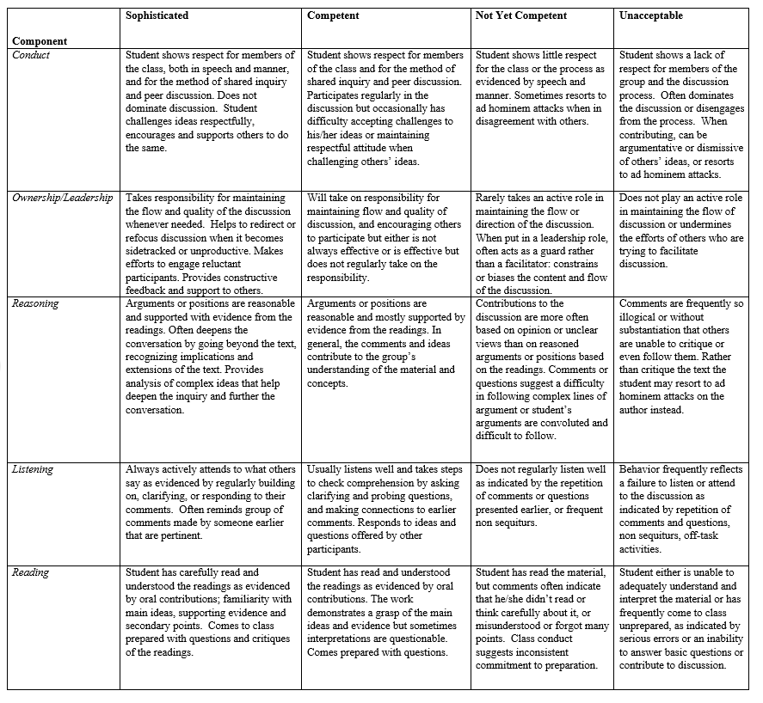
Single-Point Rubric Examples
From Carnegie Mellon’s Eberly Center
From Alison Kaufman
Notes:
Adaptation of an analytic rubric

Slide 9
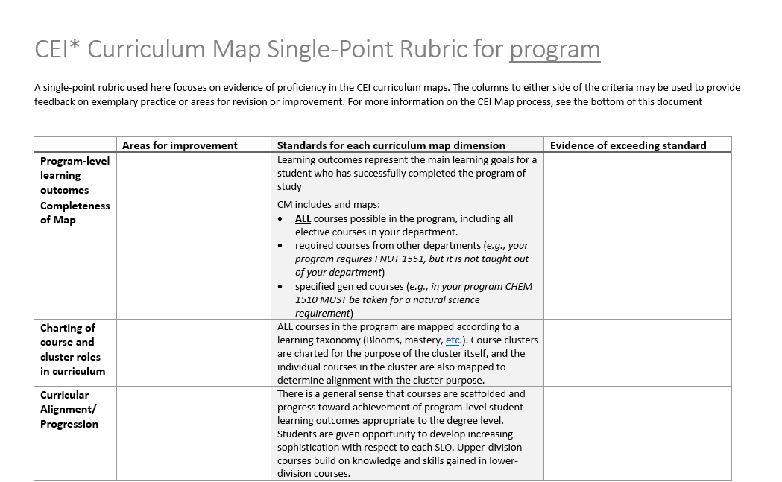
Single-Point Rubric Examples
From ITL
Notes:
Example of a criteria list turned into a single point rubric

Slide 10
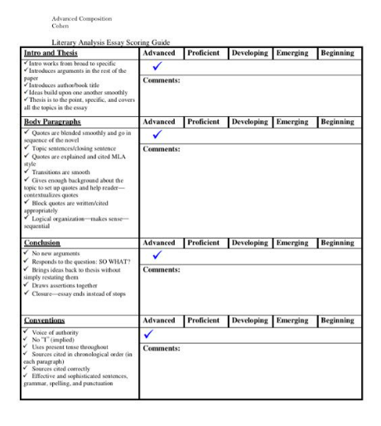
Single-Point Rubric Examples
From Lori Cohen @lcctchr
Notes:
Finally, here’s a variation on a single point rubric used with a developmental scale (beginning to advanced)—this could be a great rubric to use through a course focused on skill development (like with writing)

Slide 11
Bonus Transparent Tip: Use Exemplars
Particularly with bigger papers/projects/assignments
Provides a source of formative feedback
Provide 2-4 examples (more than one to avoid copies)
Consider including: stronger, weaker, mixed, highlight specific features
Attend to consent for examples

Slide 12
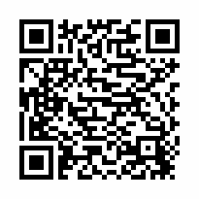
DID YOU SIGN-IN? Engage with ITL 3 times this fall through workshops, book club, podcast groups, or consults and receive a $25 gift card.
THANK YOU
for joining us today! Before you go…
Complete a feedback card or fill out a feedback form online.

