Slide 1
Youngstown State University March HCAC Meeting
March 16, 2023
Presented by: Stephanie Mueller – Account Executive

Slide 2
Agenda
2023 Health Campaign
Monthly Preventive Health Mailings
Lark Programs

Slide 3
2023 Health Campaign
Coming in 2023, a multi-channel (USPS mail, text, social media) campaign program designed to remind members to take important steps to maintain or improve their health
Communication Plan
1St Quarter Preventive Health
Targeted for Mid-March
Encourage members to schedule their annual preventive care visits/screenings
Will refer members to use MMO Find a Provider Tool
2nd Quarter Behavioral Health
3rd Quarter Where to Find Care

Slide 4
Monthly Preventive Health Mailings
Reminder, our Clinical Quality Improvement department sends monthly mailings to educate members about recommended screenings based on their age and gender.
Women Turning 40
Breast Canter Screenings
Colorectal Cancer Screenings
Cervical Cancer Screenings
Men Turning 40
Colorectal Cancer Screenings
Blood Pressure
Cholesterol
Diabetes Resource Guide
Booklet sent to members who are recently diagnosed with diabetes

Slide 5
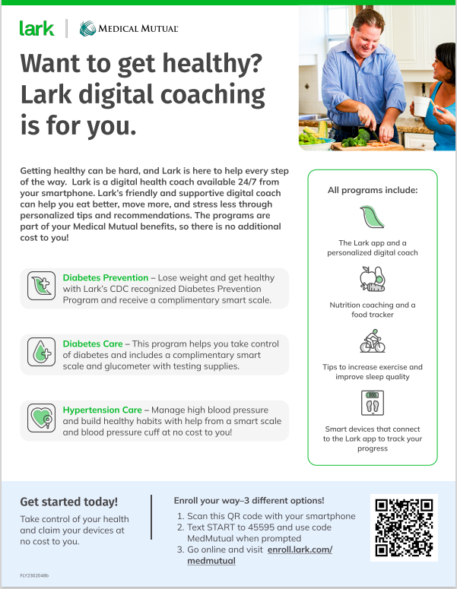
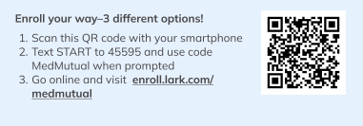
Lark Flyer

Slide 6
Thank You

