Slide 1
Youngstown State University
September HCAC Meeting
September 21, 2023
Presented by: Stephanie Mueller – Sr. Account Executive

Slide 2
Agenda
Medical Mutual Team Update
BLOOM Health Update
Behavioral & Mental Health Program
2023 Health Campaign
  2nd Quarter
  3rd Quarter
WeightWatchers Promotion
Emergency Room Redirection Member Mailing
Why We Might Call Flyer
Strive Health

Slide 3

Medical Mutual Team Updates
Beth Martin – CD
  Retired as of September 4, 2023
Mike Dylong - CD
  Mike’s contact information is below:
    Email: Michael.Dylong@MedMutual.com
    Office Phone Number: 440-572-6374
    Mobile Phone Number: 440-554-3388

Slide 4

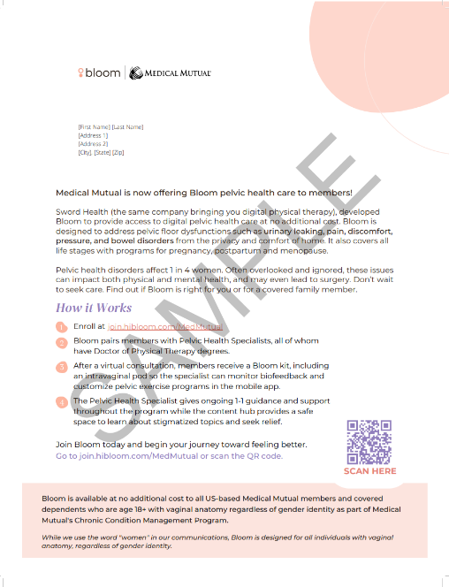

BLOOM Health
Member Outreach In Progress
Email sent to eligible members from Medical Mutual to notify of Bloom program
  Information about the free program
  Link to Enroll
  Call customer service for questions
Bloom outreach will begin on August 7,2023 based on member’s communication preference:
  Email, Text or Direct Mail
  Includes a QR code to link member to enrollment screen
Member Materials Available
Notes:
Digital Pelvic Health therapy for woman and individuals with vaginal anatomy. Pelvic floor dysfunctions such as urinary incontinence, pain, discomfort etc.

Slide 5
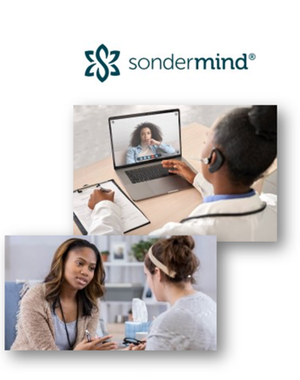
Behavioral & Mental Health Program
Partnership with Sondermind to connect members to behavioral health clinicians for in-person or virtual care
  Sondermind provides care coordination with direct access for members
Current network includes over 100 specialist in Ohio with plans to expand
Medical Mutual has Behavioral/Mental Health Case Managers to assist in complex cases
We have expanded our internal BH team to now include specialty specific physicians, nurses/case managers, social workers and care coordinators
Members can self-refer:
  Phone: (888) 966-1665
  Email: carecoordinators@sondermind.com
  Online form: Complete on sondermind.com/refer
Notes:
Navigator to assist members in where to find care. We have specialized Case Managers in BH and MH as the two go together.
Sondermind provides care coordination to members for direct access to BH services. Members can use this service to locate in-network providers in their area.
I can provide you with the self-referral information.
Phone: (888) 966-1665
Email: carecoordinators@sondermind.com
Online form: Complete on sondermind.com/refer

Slide 6
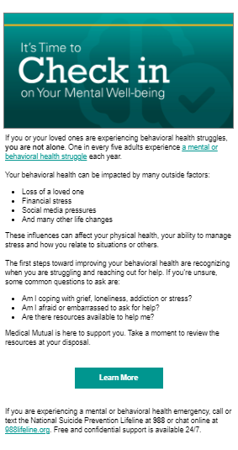
2023 Health Campaign – 2nd Quarter
Behavioral Health
  Outreach began July 27th
  Targets members 18 and over
  Email, Text Messages and Postcard
    Assures members who experience behavioral health struggles or know someone who does that they are not alone. We also provide them multiple internal and external resources to help them manage
    Provide a Landing Page for members
      Behavioral Health Checklist
      Behavioral Health Benefits and Resources
Next UP:
  3rd Quarter Campaign: Where to Find Care
Notes:
MMO is always looking for ways to engage members and remind them of the services and benefits they have available to them. 2023 Running a Quarterly Health Campaign.

Slide 7
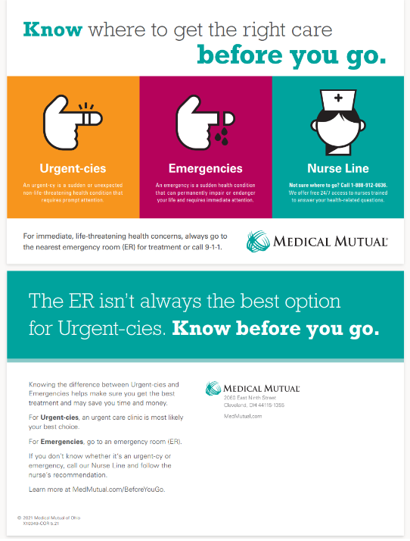
2023 Health Campaign – 3rd Quarter
Where to Find Care
  Outreach will begin in October
  Targets members 18 and over
  Email, Text Messages and Postcard
    Educates members on where to go to get the right care, depending on their symptoms. It will also promote Nurse Line as a resource to call when they are unsure of their best option.
    Provide a Landing Page for members
      Know Before You Go Resources
      What are Your Symptoms?

Slide 8

WeightWatchers® Promotion
Through our partnership with WeightWatchers® we are pleased to offer new participants in WeightWatchers® a Smart Scale promotion for the months of September and October 2023
The Smart Scale helps with easier tracking by auto-syncing with the WeightWatchers® digital app.
Helpful information:
  Sign up through October 31st to receive the free smart scale
    Where to sign up: WW.com/us/mmomembers
    Get your scale: WW.com/freescale
    As a reminder by being insured through MMO, eligible members can enroll in the discounted WW monthly membership of almost 50%.
  Marketing materials are available for group officials
  If you have any questions, please contact ww@medmutual.com

Slide 9
Emergency Room Redirection Member Mailings
As part of our ongoing efforts to reduce unnecessary ER visits, we are sending post-visit letters to members who have recently visited the ER for a non-life-threatening condition
Parents/guardians will receive the letters for those members under the age of 18
The member letter will:
  Acknowledge the member’s recent ER visit
  Encourage them to make a follow-up appointment with their PCP
  Include a chart of available places to seek care based on symptoms and urgency (Such as NurseLine, Urgent Care, Convenience Clinics)
The goal is to educate these members about ER alternatives, so they are better prepared to make a quick decisions when care is needed in the future, saving the ER for true emergencies

Slide 10
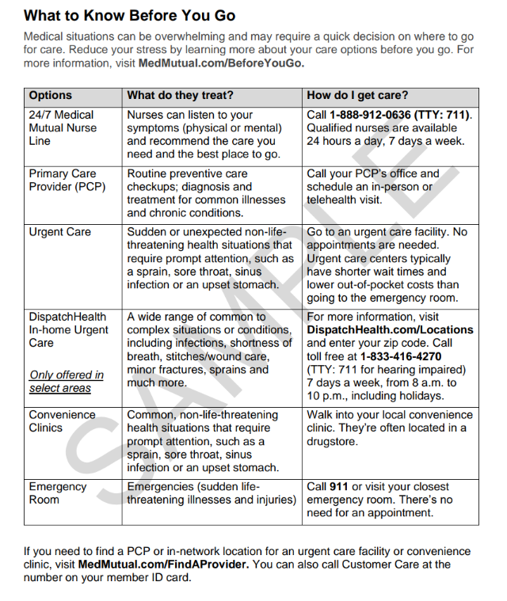
Emergency Room Redirection Member Mailings
Educational chart on ER alternatives

Slide 11

Why We Might Call Flyer
Educational flyer on outreach to members from Medical Mutual

Slide 12




Introducing Strive Health
Medical Mutual is partnering with Strive, a leading clinical organization dedicated to improving the lives of those struggling with Chronic Kidney Disease Stages 3, 4, 5, and End Stage Renal Disease (ESRD)
Strive works closely with providers as an extension of the care team to offer additional support and resources and ensure the member's nephrologist (kidney doctor) and specialists understand and comply with the member's care plan.
This leads to:
Improved patient outcomes
Fewer hospital admissions
Reduced emergency department visits

Slide 13
Introducing Strive Health: Benefits
24/7 access to a highly specialized and comprehensive KidneyHeroTM care team
SPECIALIZED NP
PROGRAM RNs
KidneyHeroesTM Care for Patients, Not Just Kidneys
RN CARE MANAGER
SOCIAL WORKER
CARE COORDINATOR
DIETICIAN
Alignment with local providers improves coordination of care and outcomes
Local community partnerships to connect patients with the right community resources
Personalized meal planning and education from dedicated Strive dieticians
Interactive and ongoing patient education

Slide 14
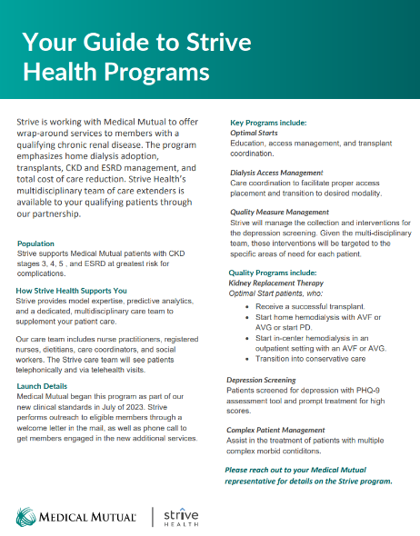
Introducing Strive Health: Important Details
Effective 1/1/24 and forward for both new and renewing groups, Strive is a part of our standard clinical offering. ASO groups must decline coverage if they do not want the programs.
Program cost is $200-400 per engaged member per month (range is based on CKD stages 3-5 & ESRD)
Notes:
13 members with Chronic KD

Slide 15


Thank You

