Slide 1
Teach Out Strategies
Plan for Students Enrolled in a Sunset Program

Slide 2
Formed a Committee
Kevin Ball, Associate Provost, Academic Programs and Planning
Claire Berardini, Associate Provost, Student Success
Jeanne Herman, University Registrar
Sal Sanders, Dean and Assistant Provost, College of Graduate Studies

Slide 3
Made A Plan
Done
In Progress
To Be Completed
Identified Students
Created degree audits via Penguin PASS
Distributed audits to academic departments, program coordinators and academic advisors
Advisors outreach to students
Review of courses needed for degree completion
Student plans
Identify alternate courses for degree completion
Identify alternate methods of specific course offerings
Reassess students within this group after spring registration

Slide 4
Degree Audits for Review
Academic Department
Curricular/Degree Completion
Advisement/Student

Slide 5
Academic Department Level
Chairs and Program Coordinators working with Registrar Office
Impact on course availability for spring and summer
Impact on faculty
Course substitutions when possible

Slide 6
Curricular/Degree Completion Level
Chairs and Program Coordinators working with Registrar Office
Remaining course work for degree completion
Identify key courses that should be taken spring and summer
Estimate completion date for students in sunset programs

Slide 7
Advisement/Student Level
Academic Advisors working with OAA
Outreach to students
Possible major change
Reassess after spring registration
Provide student with expected graduation date

Slide 8
Student Educational Plan
Student Educational Plan is a tool within Penguin PASS
Individual completion plan that lists required courses by semester
Based on student preferences
Plans created by advisor; reviewed by student
Students have access to plan in Penguin PASS

Slide 9
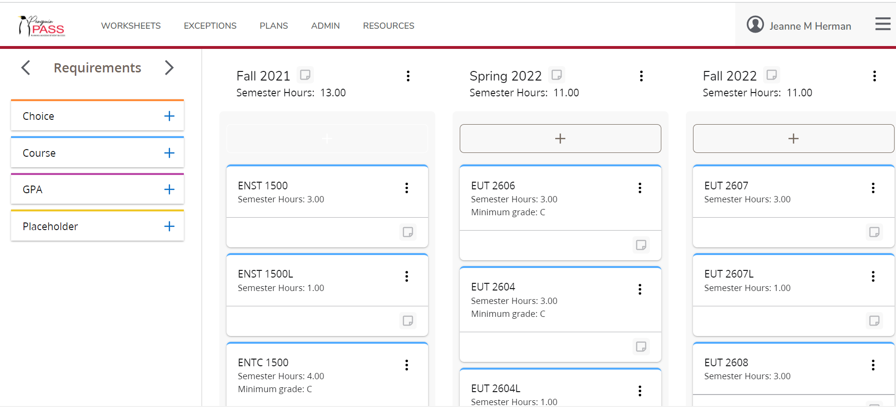
Student Plans in Penguin PASS

Slide 10

Next Steps
Review after Spring registration is final
Continued outreach to students within programs

