Slide 1

Supporting Student Mental Health Remotely
Ann Tierney Jaronski, PhD
Licensed Psychologist
Director, YSU Student Counseling Services

Slide 2
Objectives
Learn the value of asking, listening, acknowledging, supporting, challenging and connecting.
What is your role and scope of care as an educator
Learn about additional resources for you and your students.

Slide 3
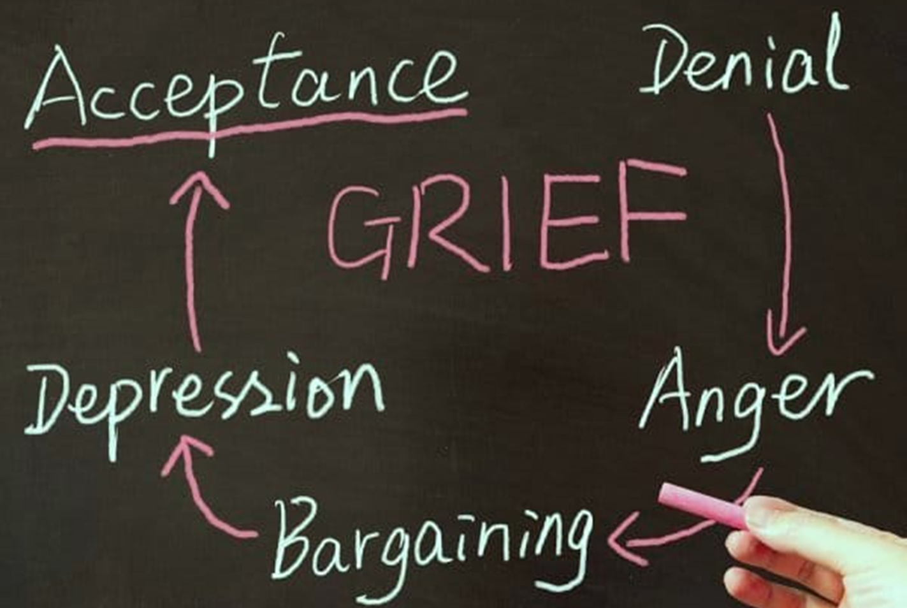
Individual and Collective Grief
Notes:
One way to understand our collective and individual experiences right now is through the lens of Grief

Slide 4
Stages of Grief
Denial – Shock; Avoidance; Disorientation; “This is not really happening!”
Anger, Anxiety & Fear
Anger about imposed disruptions/restrictions and loss of agency/control
Anger towards decision makers (politicians, health authorities, YSU) & perceived source(s) of pandemic (China, Asians, Asian-Americans)
Health & safety concerns for ourselves and others
Worry about academics, internships, job market, finances, etc.
Bargaining – negotiating to change or circumvent the reality of the situation
Depression
Sadness about abrupt and unexpected losses (milestones, celebrations, future plans, relationships, sense of safety, $$; etc.)
Loneliness, Boredom and Helplessness
Acceptance – Reconciliation; Meaning Making; Pivoting; Planning; → Resiliency/Growth
Notes:
Some of these sentiments may feel familiar

Slide 5

Anticipatory Grief
Uncertainty about duration and implications of pandemic.
Uncertainty about what the future holds.
Sense of foreboding & apprehension.
Loss of safety.
Notes:
There is also anticipatory grief

Slide 6


The five stages of grief are tools to help us frame and identify what we may be feeling.
But they are not stops on some linear timeline in grief.
Not everyone goes through all of them or in a prescribed order.
~Elizabeth Kubler-Ross and David Kessler
From On Grief and Grieving
Notes:
It’s important to note that…

Slide 7

Additional emotions people may be experiencing
Anxious
Stressed
Worried
Fearful
Low
Lonely
Overwhelmed
Helpless
Frustrated
Guilty
Angry

Slide 8


Who may be vulnerable ?
International Students
Students of Color
Queer-Spectrum & Trans-Spectrum Students
Students Dealing with Violence in the Home
Housing/Food/Resource-Insecure Students
Students who are caregivers to Children or Elders
Students with Disabilities
Students Managing Anxiety, Depression, Etc.
Students who are military-connected
And many others!
Notes:
Graduating seniors
Students with field placements
Students who are performing research in labs
First year students

Slide 9
To help support Student’s Mental health needs
Notes:
So what can we do

Slide 10
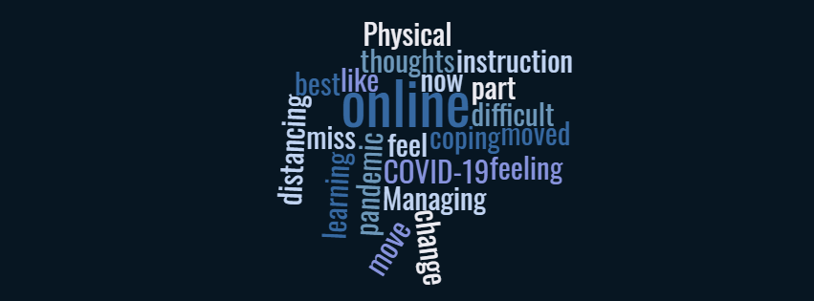

Ask
Being curious and asking about someone is better than assuming that you know how they feel.
Notes:
This would also apply to yourself
Ask yourself how are you doing? Where are you getting stuck
What are the benefits you are experiencing right now?
What is out of your control?
What do you have control over?

Slide 11
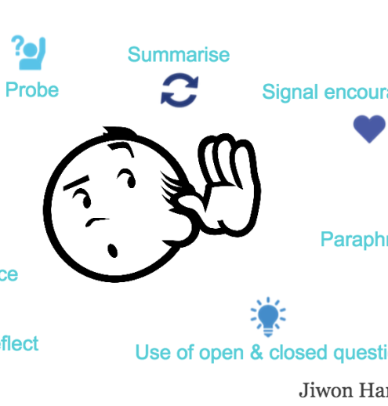
Listen
To understand, not respond
Give them space to find the words.
Listen patiently.
Notes:
Too often we try to “fix” things
You don’t have to have the answer or fix
Holding space and listening is important and helpful

Slide 12


Acknowledge
Acknowledge important feelings and experiences
Notes:
Acknowledge what was said
Acknowledge your own feelings and experiences – at least to yourself

Slide 13

Support Challenge Encourage
Notes:
Growth occurs when we are challenged in ways that we can achieve
We don’t learn as much when things are easy, although it may “feel better”
Examples: weightlifting
learning
Finding that sweet spot of challenge vs support
Utilize appropriate encouragement
Be honest if someone is not doing well

Slide 14
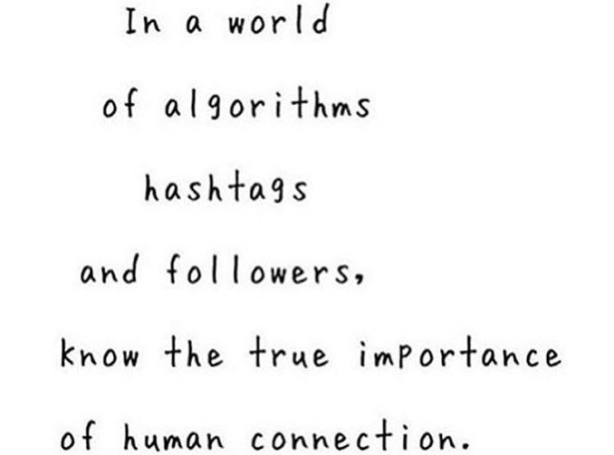
Connect
People want to be:
Seen
Valued
Heard
Notes:
Your online presence, response questions, connections with students are important
Practice physical distancing, not social distancing

Slide 15

Boundaries
Your Role and Scope as an educator
Notes:
You are not
friend
therapist
parent
child
You are
instructor
educator
faculty
adult
It’s ok to have boundaries, to say no, to have appropriately limited access, to have down time for yourself
Identify your boundaries
Speak them
Enforce with actions
Be consistent

Slide 16

For many
distress may come later
Notes:
Some will be coping well right now
Some people rise to a challenge and may see this as a temporary challenge
Some will find distress later

Slide 17
Resources
Notes:
So you have asked, listened, acknowledged, challenged, supported and encouraged
You have identified that someone needs more assistance than you can provide in your role and scope
So let’s talk mental health resources

Slide 18

Resources: YSU
330-941-3737
StudentCounseling@ysu.edu
https://ysu.edu/student-counseling-services
Providing: Consultation, Assessment & Referral, Crisis response via telephone
Afterhours, weekend and holiday phone consultation and response also available by calling our main number and pressing “1” after the message. Your call will be transferred to a mental health professional.

Slide 19
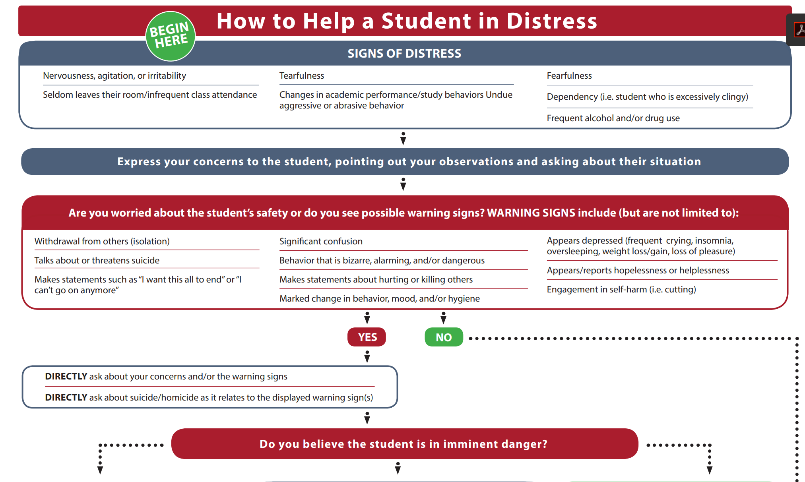
Resources: YSU
How to help a student in distress: https://ysu.edu/sites/default/files/student_counseling_services/HowToHelpaStudentInDistress_ADA.pdf

Slide 20

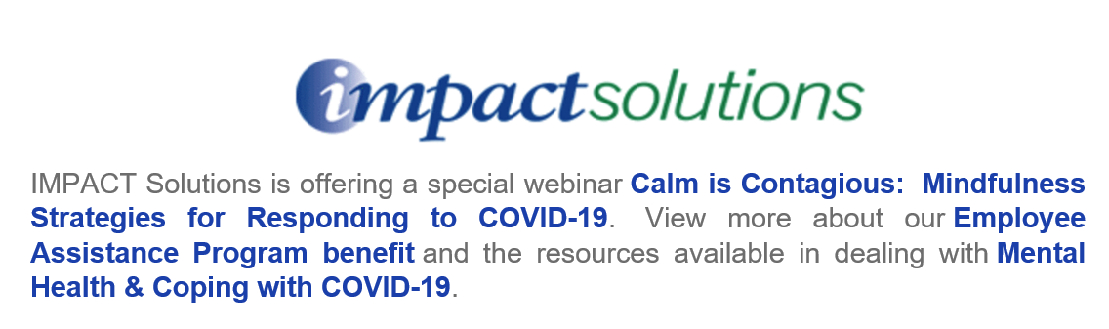

Resources: Faculty
https://ysu.edu/employee-wellness-program/employee-wellness-program

Slide 21
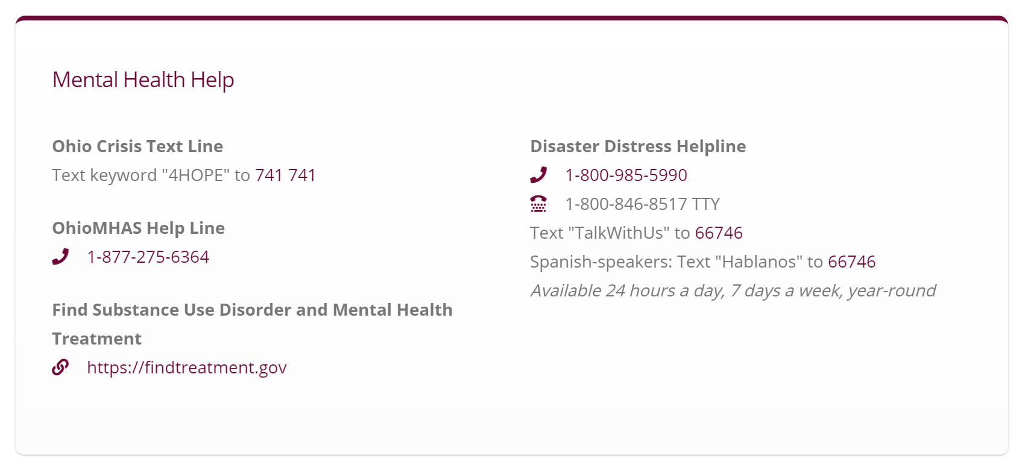
Resources: For all, Ohio Specific

Slide 22
Resources: Virtual self-care
https://www.traumasensitiveyoga.com/online-tctsy.html
Free online trauma sensitive yoga classes
https://www.headspace.com/covid-19
Free Headspace meditations
https://www.youtube.com/playlist?list=PLVlLbxLe1Eo51f-BqC3u48AyikKun3mcT
Dialectical Behavioral Therapy Crisis Survival Skills video playlist
https://www.sanvello.com/
Sanvello (formerly Pacifica) is offering FREE Premium access to on-demand help for stress, anxiety, and depression.
https://free.healthjourneys.com/
Free daily meditations for kids and adults.
https://www.taoconnect.org/english-exercises/
TAO Connect has made meditations free online.
https://hope4college.com/
The Hope Center advocates for students’ basic needs, and has resources for food-insecurity, housing, childcare, transportation, and mental health care.

Slide 23
Resources: National
National Suicide Prevention Lifeline
800-273 –TALK (8255)
Crisis Text Line
Text HOME to 741741

Slide 24
Questions?

