Slide 1
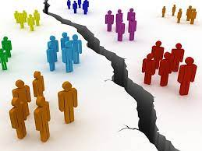
Classroom Management in Divided Times
Monica Merrill
ITL Fellow
Department of Criminal Justice and Consumer Sciences
October 26th, 2021

Slide 2
4 Reactions to Polarizing Material
Paralysis
(Paralysis by Proxy)
Rage
Resistance
Davis, N. J. (1992). Teaching about inequality: Student resistance, paralysis, and rage. Teaching Sociology, 232-238.

Slide 3


Paralysis
Happens when confronting inequity or uneven distributions of power
“Stratification systems become reified: external, entrenched, and outside of human agency (Davis, 1992:235)
Tends to happen when collective mobilization is vilified

Slide 4
Paralysis Quotes
“I also tend to shut down when I feel like there is nothing I can do to fix or even fully understand an issue, which could lead to me performing poorly on assignments, or opting out of them all together”
“As a criminal justice student, a large portion of what you hear about this system is negative. The clear racial inequalities and sentencing disparity among other injustices has been an issue for decades. At times, it feels like a system that is too stubborn to change its ways and as one person, it feels as if your efforts, no matter how valiant, will not make a big difference if it makes any at all due to how massive these issues are and how long they have stood the test of time”

Slide 5
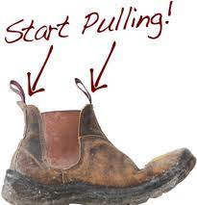
Paralysis by Proxy
Thinking that marginalized groups either can’t or won’t better themselves
“I see a lot of people in my work who just can’t or won’t better themselves. I’m not sure which it is. But I’m not sure how I am supposed to help them if they can’t or won’t help themselves.”
Students retain all the power, allow no agency for underserved individuals

Slide 6

Rage
Reliance on reductionist thinking and “blindness to the complexities of hierarchical societies and to the multiple forms that stratification takes” (Davis, 1992: 236)
Excitable group ☺

Slide 7
Rage Quotes
“I’m a very stubborn and passionate person when it comes to social inequality. Sometimes I get so mad that I can’t think straight”
“Last semester I took a class about social inequality, and it was full of people who didn’t look like they had ever lived an unequal day in their lives. It was a bit distracting to hear their views on inequality when it doesn’t seem like they ever experienced any”

Slide 8
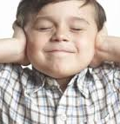
Resistance
“…deny the existence or importance of inequality or may argue that no intervention is needed” (Davis, 1992: 232)
3 types
“Fake news”
Strong reliance on individual explanations
“Victim”-blaming

Slide 9
Resistance Quotes
“Sometimes I get anxiety if something is not the way I thought it was. It is hard for me to hear things that are different than how I was raised and what I was taught was true”
“…because I like to challenge ideas and professors’ presentation of those ideas. This isn’t done overtly, and disrespectfully, rather I just like to see all the information on a subject, not what someone else decided was most important for me to know. Therefore, until I can get a chance to see all the information, I don’t accept (or reject) what I’m told in these settings.”
“People do not want to believe they are at an advantage or disadvantage from something that is out of their control”

Slide 10
Application?
What are some ways students react in your classrooms when discussing “touchy” subjects?

Slide 11
How Can we Help?
Strategies for Paralysis
Examples of effective collective mobilization
Current strikes, social service programming,
Volunteer opportunities or service learning
Strategies for Paralysis by Proxy
Real life examples/stories (StoryCorp, The Moth, Testimonial websites)
Interactive Games: Playspent.org, Reentry simulation

Slide 12
How Can We Help?
Rage
Real life examples/stories (StoryCorp, The Moth, Testimonial websites)
Interactive Games: Playspent.org, Reentry simulation
Focus on allyship, bystander interventions,

Slide 13
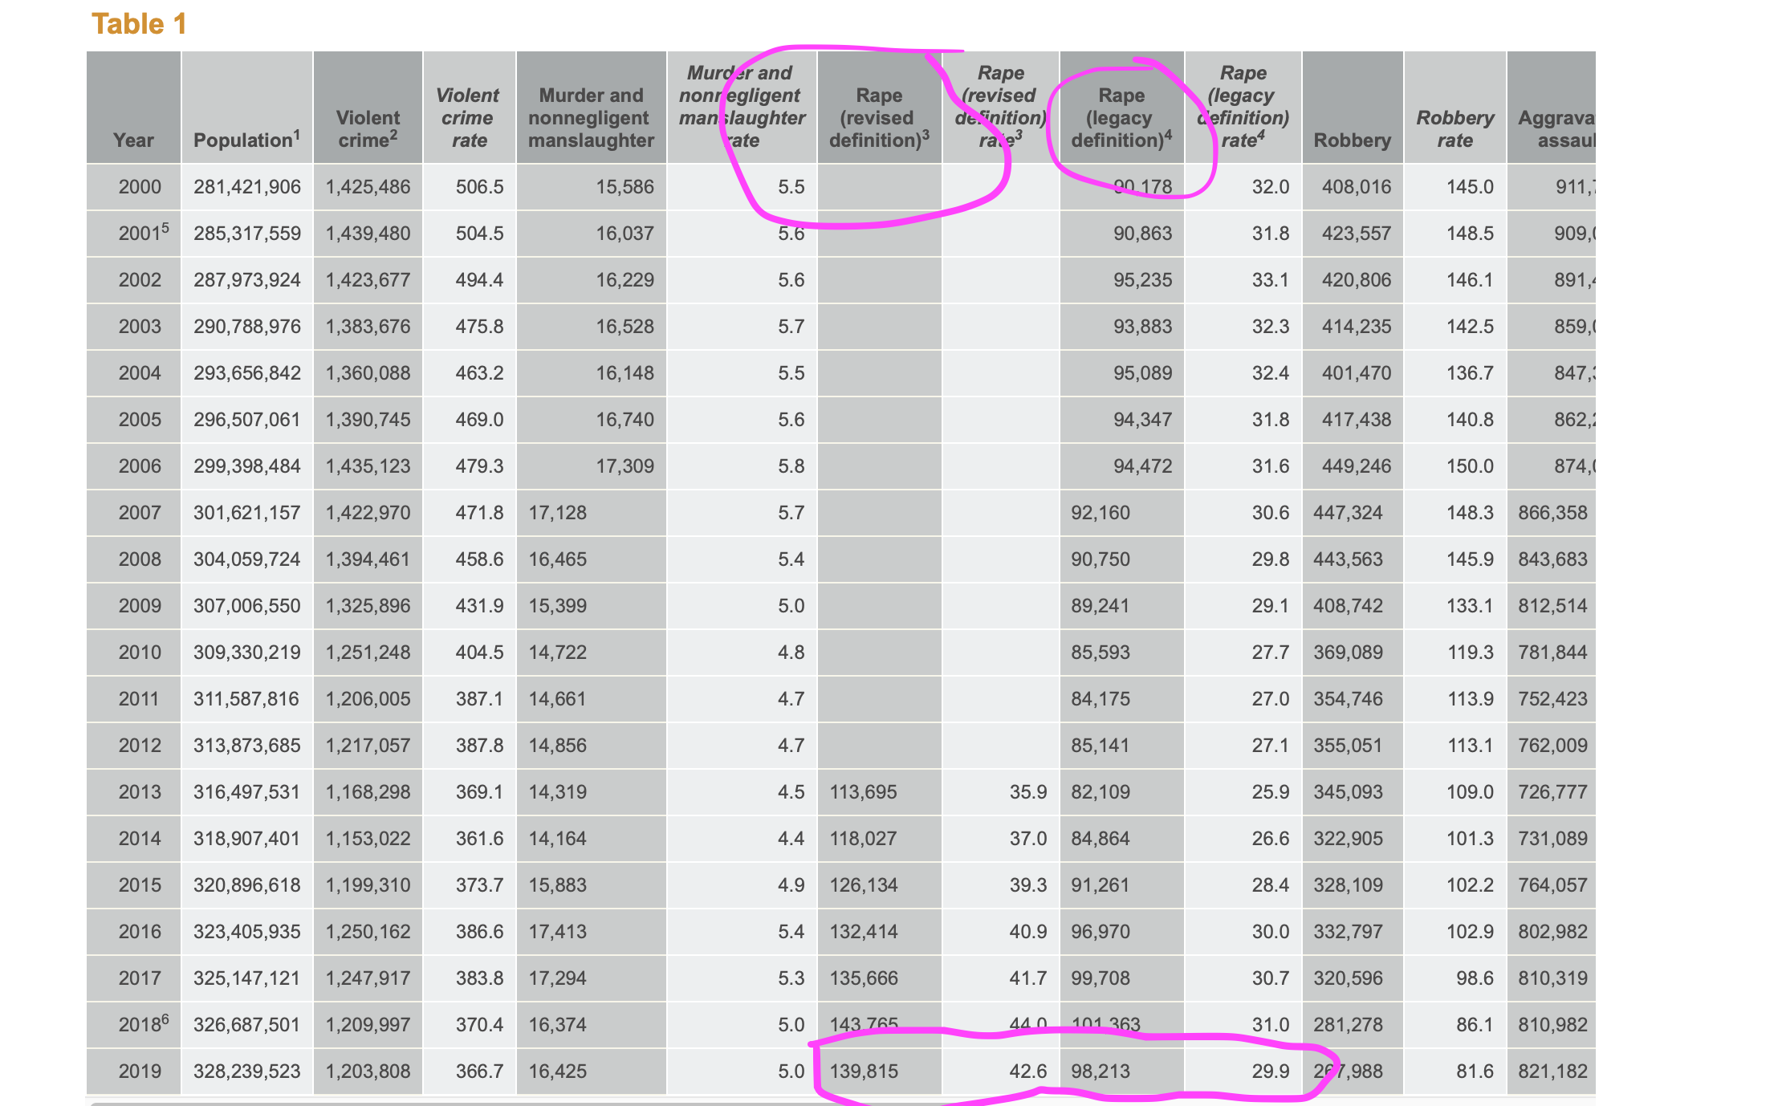
How Can we Help?
Resistance
Examples
Focus on research methodologies
Ask them to create a better way/method

