Slide 1
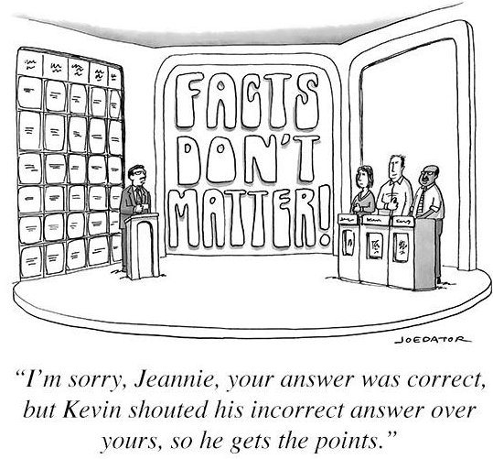
Telling Fact from Fiction: Information Literacy with Students
Monica Merrill
ITL Faculty Fellow
Criminal Justice and Consumer Sciences
October 7th, 2021

Slide 2

Overview
  Identifying the importance of identifying facts
  Examples of poor quality or misinformation
    Tools to differentiate quality information
    Incorporating these lessons into existing classes throughout.

Slide 3

The struggle telling fact from opinion
  PEW Research Poll
    Out of 10 fact/opinion statements
      Only 25% correctly identified all the facts
      Barely 1/3 correctly identified all the opinion statements

Slide 4
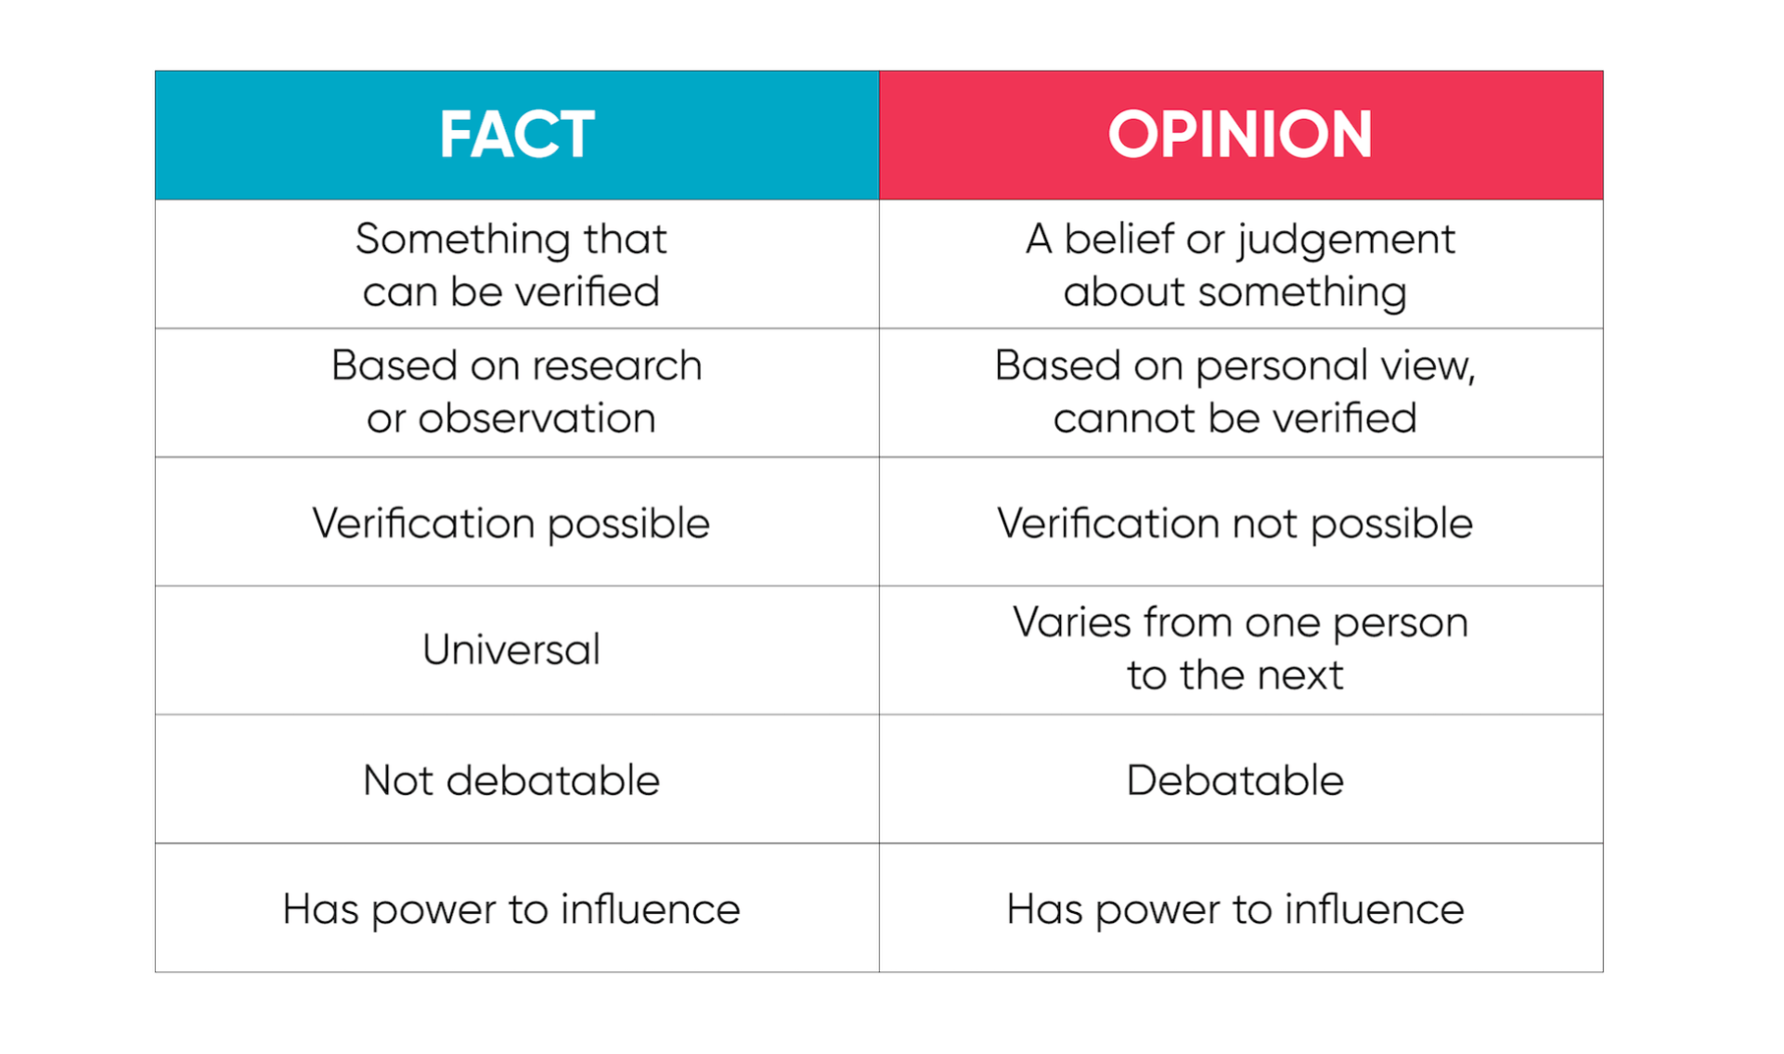
Fact vs. Opinion

Slide 5
Finding reliable information
Focus on civic reasoning
  focus on what information is worthy of trust
  Understand where information comes from and who is responsible for presenting it
Notes:
https://www.aft.org/sites/default/files/periodicals/ae_fall2017_mcgrew.pdf

Slide 6
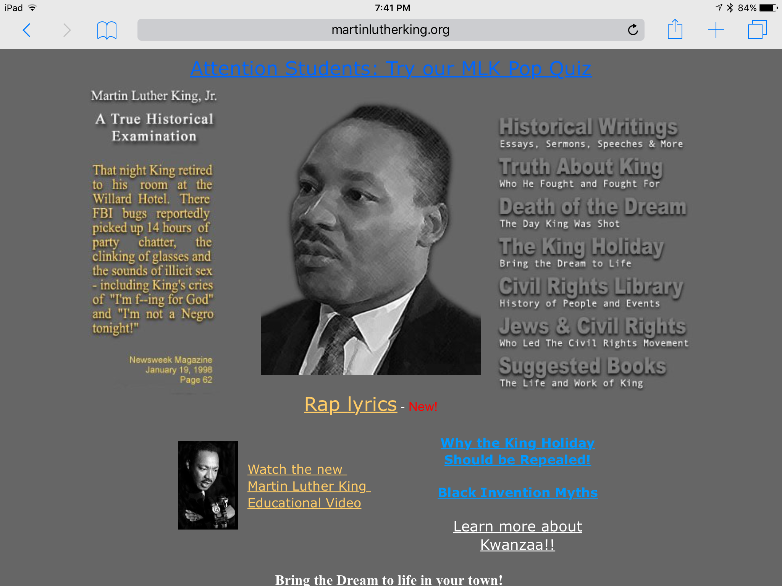
”Fake News” Examples
Owned by Stormfront
  Now offline

Slide 7
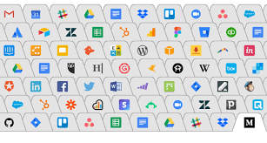
Tool #1- Lateral Reading
Lateral reading- searching for information about a source while you are reading it

Slide 8


Fake News Examples
American College of Pediatricians
  SPLC Recognition

Slide 9
Tool #2: About Us
Use this tool!
Most websites will state mission, strategic plan, etc.
ACP vs. APA example

Slide 10
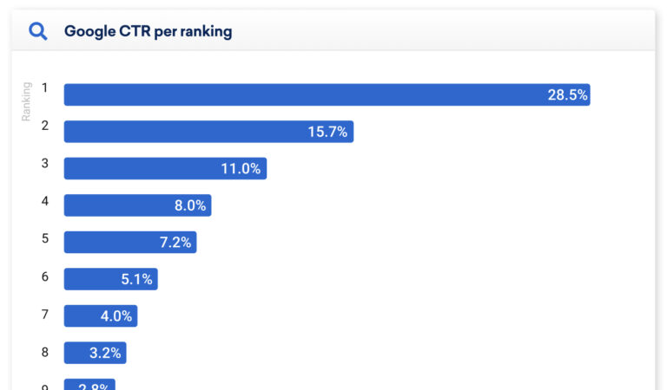
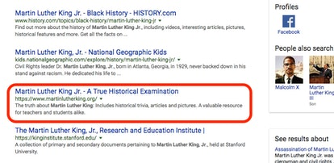
Choosing websites in searches
Understand basics of how algorithms work
  Keywords
  “quality”

Slide 11
Tool #3- Click Restraint
Breathe!
Search tips:
  Use “keywords in order”
  Use :
    ysu.edu: itl
    Site:edu keyword
  Use – to eliminate websites or keywords
    Kellogg’s strike –Kellogg’s.com
  **If you are citing a terrible website, don’t link! Use martinglutherkingDOTorg

Slide 12
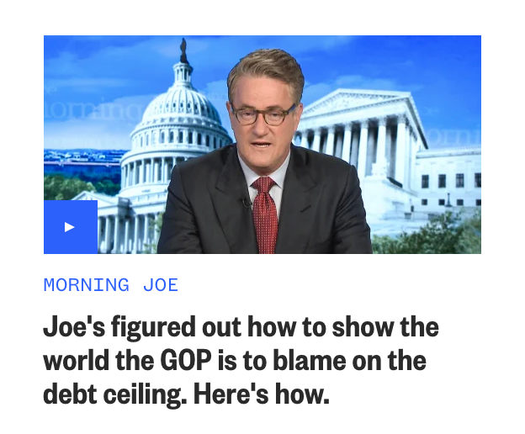
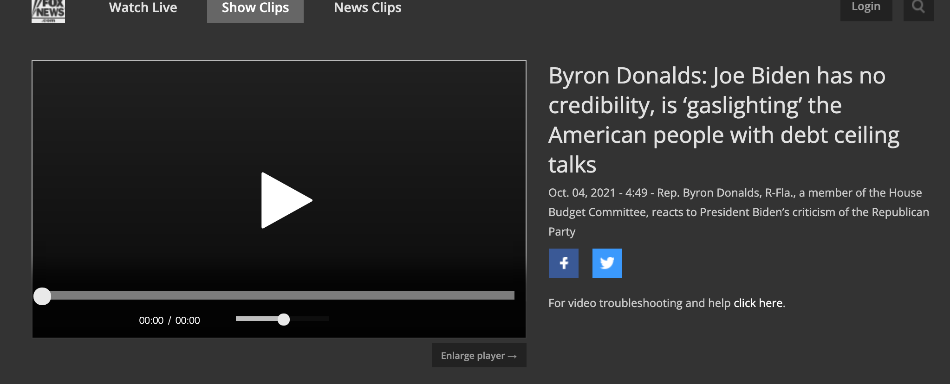
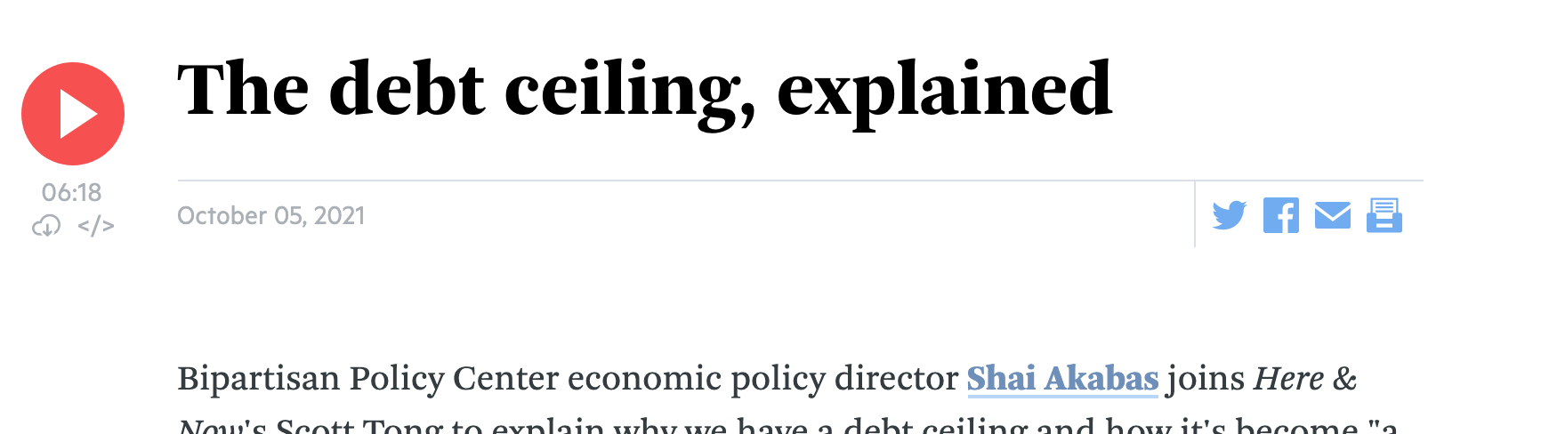
Media Bias

Slide 13
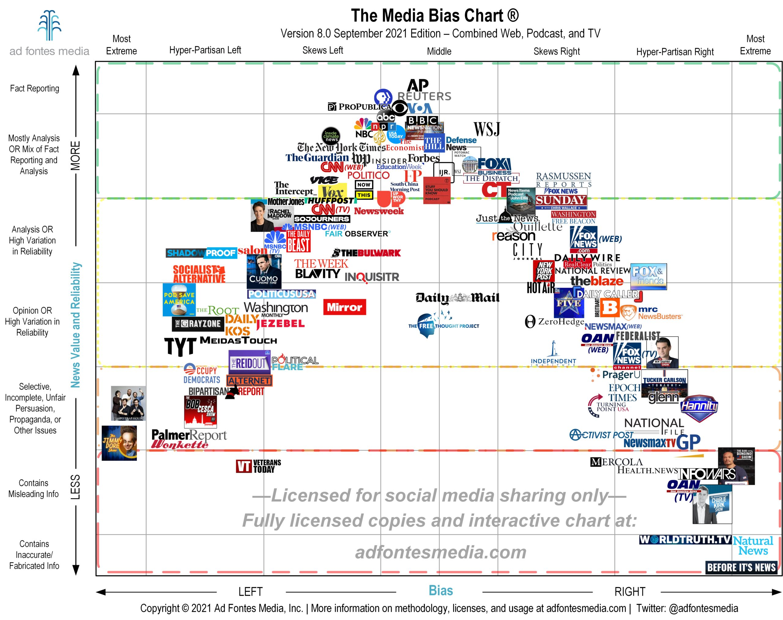
Tool #3: Identifying bias
Biased or fake news

Slide 14
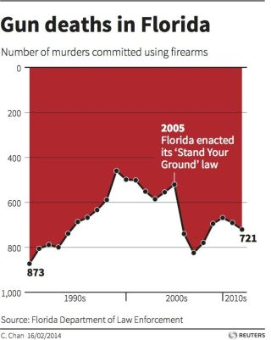
Deceiving Visual Aids
Designer- “It’s a preference”

Slide 15
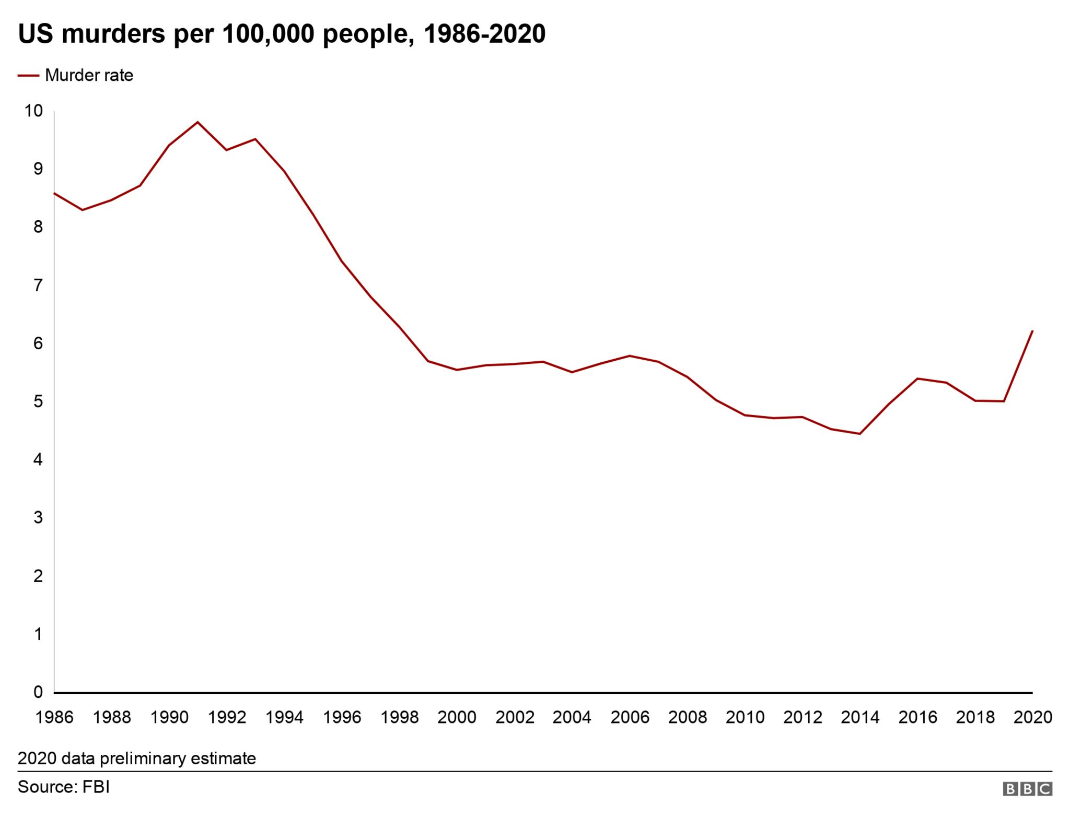
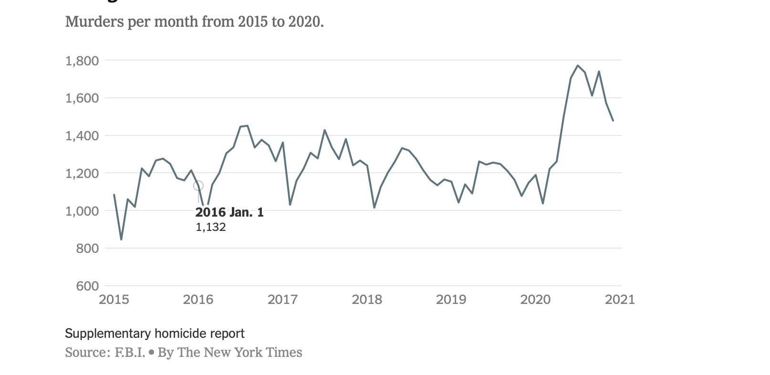
Deceiving Visual Aids

Slide 16
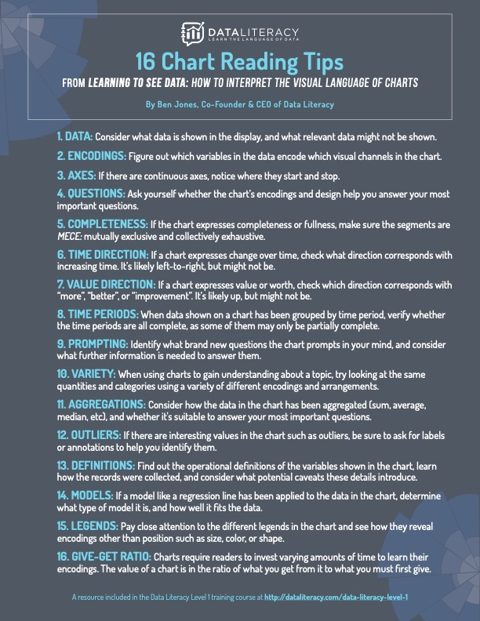
Tool #4 Visual Data Literacy
NYT What’s Going on in this graph?

Slide 17
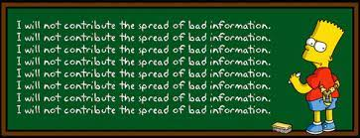
Quality of information?
Particularly important for polarizing topics
Too many examples to pick!

Slide 18
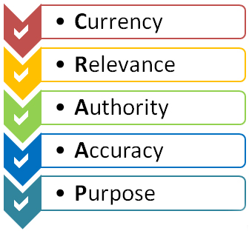
Tool #5- CRAAP Test
Fact or Crap
Recent research moving away from checklists like this
  Still useful in conjunction with other tools

Slide 19
Sum up
5 Useful Tools
  **Lateral reading
  Use About Us Section of websites
  Click Restraint
  Identify Media Bias
  Practice Visual Data Literacy
  How can you incorporate these ideas into your courses?

Slide 20
Conclusion
Thank you!
Any questions feel free to contact me
  mmmerrill@ysu.edu

