Slide 1
Records Retention, Public Records & Historical Records Training

Slide 2
Topics Today - Public Records
Sunshine Laws
Board policies
What is a public record
Quiz
What to do with a public records request

Slide 3
The Sunshine Laws
Ohio’s Public Records Act
Ohio’s Open Meetings Act
Notes:
In the 1950s and 1960s, the Ohio General Assembly enacted “sunshine laws” to assist citizens who wanted to obtain information from the state of Ohio and from public agencies in the state like public universities. YSU is a public university in the State of Ohio that is subject to the Sunshine Laws.
The idea is to prevent public institutions from keeping information hidden away in secret in the dark behind closed doors and instead open those doors to let the sun shine in and let citizens learn about what their government agencies are doing. We are focusing today on the public records act. The open meetings act also applies to YSU and is the reason, for example, that our board of trustees hold open meetings to the public, but today we are only focusing on records.

Slide 4
Hallmarks of Democracy
Provide a critical tool to fight corruption
Hold governments accountable
Increase government efficiency and responsiveness
Promote civic trust
These apply to government institutions and public universities, not to private companies
We are all responsible for public records at YSU, but some individuals are designated as records custodians to oversee retention and disposal of records in their area.
Notes:
So don’t just think this is some everyday training on policies and procedures-you are here learning about these laws and your role in this democratic process. You work for a public institution and when you interact with the public when someone asks for public records or when you are handling public records, you are representing the university as a public institution of the State of Ohio. It is very important that you understand your duties and fulfill them as required by law.

Slide 5
Two Board of Trustees’ Policies
3356-9-07 Public Records
3356-9-09 Records Management

Slide 6
What is a public record?
A “public record” is
(1) any document, device or item, regardless of physical form or characteristic, including paper, electronic, email or other format;
(2) that is created or received by or comes under the jurisdiction of a public office (YSU is a public office); and
(3) that documents the organization, functions, policies, decisions, procedures, operations, or other activities of the office.
All records of the university are public unless they are specifically exempt from disclosure under law
(Example medical records are not public records.)
Test:
Stored on a fixed medium?
Created, received or kept by YSU?
Documents activities of YSU?
3356-9-07 Public records.
Notes:
This BOT policy on Public records defines what constitutes a public record in keeping with the statutory definition in the Ohio Revised Code.

Slide 7
Q: When is something a “record?” A: When it can be stored in a fixed medium.
Paper/documents
Email
Voicemail messages
Text messages
Meeting minutes
Map
Blueprint
Photograph
Video recording
CD
Recordings of Zoom, WebEx, Teams, etc. meetings
Notes:
This first element of the definition of a record focuses on the existence of a information in a fixed form. It is fairly broad. It does not matter what the physical form is as long as it can record information. Except for thoughts and unrecorded conversations, most public office information is stored on a fixed medium of some sort. Think of both analog and digital or electronic storage.

Slide 8
PUBLIC RECORDS DO NOT INCLUDE
personal notes you take at a meeting to jog your own memory later
unrecorded oral conversations between employees
unsolicited catalogs and junk mail/spam sent to YSU
Listserv®materials
personal emails unrelated to the university
Faculty papers deemed to belong to the faculty
journals, books, other library materials
Certain documents are also exempt from disclosure by law like:
Medical records
FERPA
Attorney-client privilege
Test:
Stored on a fixed medium?
Created, received or kept by YSU?
Documents activities of YSU?

Slide 9
Quiz
Personal calendar you keep at work
Emails on YSU’s server discussing an employee’s upcoming wedding
Screen shots of snap chat messages between two faculty members discussing YSU-sponsored travel to an upcoming international conference in their field
Draft policy document on WCBA internship requirements distributed to faculty for review and comment
Work-related voice messages left by your supervisor on your cell phone while you were working at home during the pandemic
Procurement records that were shredded according to the YSU Records Retention Schedule
Test:
Stored on a fixed medium?
Created, received or kept by YSU?
Documents activities of YSU?

Slide 10
Transient records
Have a very short‐lived administrative, legal or fiscal value and should be disposed in an appropriate manner once that use has expired, providing there is no legal hold.
Retention is not a fixed period of time and is event driven; it maybe a short as a few hours and could be as long as several days or weeks.
Transient/transitory records may include, but are not limited to:
preliminary drafts (when superseded)
voice mails and telephone messages
memoranda (paper or email) pertaining to scheduling an event
documents designated as superseded or up-dated
user copies (not original documents)
routing slips, telephone message slips and post-it notes
Notes:
Transient records are a type of public records, assuming they meet the definition of public record, but as Lisa will explain, transient records are treated differently from other records so look out for them.

Slide 11
What to do with a Public Records Request?
Take all requests seriously even if anonymous or made orally-there is NO REQUIRED FORM FOR RECORDS REQUESTS
If the request is a routine one, and your department has been trained on how to handle public record requests, respond to it.
If the request is not routine or you do not know how to handle it, call the Office of General Counsel and ask.
If the records sought were already properly destroyed, inform them and attach the certificate of records destruction.

Slide 12
3356-9-09 Records Management
Outlines management methods applied to the creation, utilization, maintenance, retention, preservation, and disposition of the university’s records the records retention program for YSU
YSU adopted the manual used by other Ohio public universities for records retention

Slide 13
Records Management
Notes:
The systematic control of all records from creation or receipt through processing, distribution, maintenance and retrieval, to final disposition.

Slide 14
Why do we need a records management program?
Document management decisions
Historical reference of transactions and events
Enhances the organizations operational efficiencies
Demonstrates regulatory compliance with Section 149.33 of the Ohio Revised Code
Provide litigation support
Notes:
For bullet 3 By reducing junk=less filing errors and faster information retrieval
For bullet 3 Cost savings through: space saving, staff saving time, and equipment saving. People tend to keep records longer than their retention period. Takes time to go through records but ends up saving time in the future.
For bullet 5 A good records management program protects the organization in case of litigation. It ensures that the records that should exist do in fact exist and the records that should not exist do not exist. It also ensure that records prepared by the university can be readily admitted into evidence to support the university’s claims. It is also protection. The failure to produce documents in response to a court order can effectively be overcome by citing evidence that the records had been destroy in the regular course of business under an approved records retention program prior to litigation.
Never selectively destroy records. Destroy entire groups or classes of records in the regular course of business under an approved records schedule (skupsky, 47).

Slide 15
Evaluating Records
Step 1: Identify the records
What is a record?
Step 2: Determine how long the records should be kept
Using the Records Retention Schedule
Litigation?
Step 3: Decide what should be done with the records
Certificate of Records Destruction
Certificate of Records Transfer
Notes:
All information regardless of format created or received by a university office in a fixed medium that documents the functions, policies, procedures, decisions, operations or other activities of the office is a record.

Slide 16
Different records have different outcomes
5 general retentions for records:
Indefinite
Long-term (longer than 10 years)
Intermediate (10 years or less)
Transient (while active)
Non-records
https://library.osu.edu/osu-records-management/pacman-effect Image
Notes:
It is important to note that a significant amount to documents that we handle on a daily basis fall into transient records or non-records. When we routinely and appropriately dispose of these records, we can more effectively expend our energies on managing those records which have extended value. If we do not perform these routine disposals of records with extremely short retention periods, we run the risk of generating such large volumes of documents, that we will overwhelm our ability to effectively mange our records.
If it is not considered a public record like emails discussing an upcoming wedding-it is not subject to the record retention policy or schedule. You can just delete it.
But if it is a true public record, including a transient record, the records retention schedule will tell you how to dispose of it.

Slide 17
Using our Records Retention Schedule
http://www.maag.ysu.edu Maag Library website
http://www.maag.ysu.edu/recordsmgt Records Management website
Arranged by Functional Series
Keyword searchable
Based on the Inter-University Council’s retention schedule
Use Records Series description to find your records
Notes:
The records retention schedule is arranged by Functional Series in groups such as Accounting and Financial, Administrative, Human Resources, Legal, Student and Course records.
Condensed/simplified version of the IUC Manual specific to the documents that we have seen at YSU. If you can’t find the records series for your document, contact the Archives and Special Collections.
It is broad based to cover various types of records. Read through the description to find which Records Series Title fits your group of records. Remember we do not want to selectively destroy records but rather groups of records. Record Series Title should be reflected on the destruction form. Give example of looking for Study Abroad Student Records.
Note to bookmark Records management website.

Slide 18
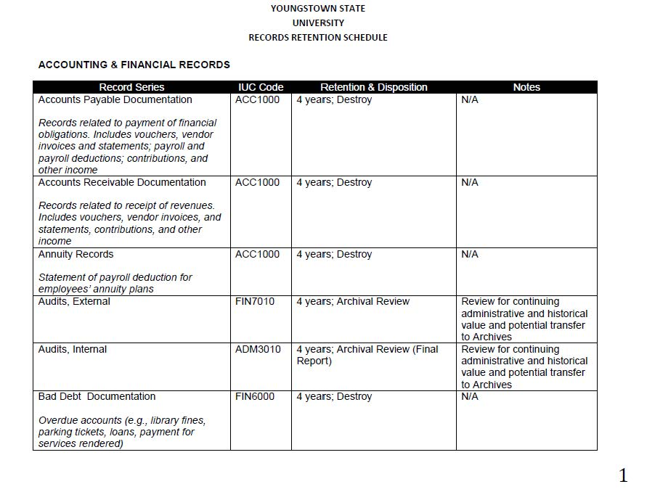
Determine how long records should be kept
Retention and Disposition column
Shorter than mentioned, keep the records
Longer than mentioned, continue to next step
Litigation/Investigation
Keep records until litigation is completed
Notes:
Retention is given in the number of years. You need to know what time period is represented in your documents in order to determine whether or not you have kept them for the required time.
The retention period is determined through state and national laws based on administrative, fiscal and legal considerations.
Somethings to consider before moving on.

Slide 19
What does “Active” mean?
A record that is regularly referenced or required for current use.
In regards to contracts and documents based on a timeline or event – active until timeline or event has passed.
In regards to students documents – active until absent 3 consecutive semesters.
In regards to employee files – as long as the employee is working at YSU.
Notes:
For student records: Active in Banner is different than it is for records management. In banner, you would look for the term “Current” To search for a large amount of student records fill out a team dynamics web focus report.

Slide 20
Transient records
Preliminary drafts (when superseded), memoranda (paper or email) pertaining to scheduling an event, documents designated as up-dated, user copies (not original documents), and routing slips
Keep while active, then destroy.
Do not need prior authority to destroy transient records. No Certificate of Records Destruction is needed!
Notes:
Records, other than the official set, may be destroyed after the user no longer needs them (skupsky 78).
Needed to eliminate unnecessary duplication of records between offices.

Slide 21
Decide what should be done with the records
Destroy:
Fill out a Certificate of Records Destruction
Send the form to archives@ysu.edu
Wait to receive a signed form back
Keep signed form for your records
Destroy documents in a secure fashion (Shredding through university vendor)

Slide 22
Decide what should be done with the records
Transfer to Archives:
Call or email the YSU Archives for transfer approval
Fill out a Records Transfer Form
Arrange with the Archives a method of transfer of materials to the Archives (digital or physical)
Notes:
If something is marked as “archival review” in the retention schedule, please contact the Archives and Special Collections. Your records might be a good candidate for transfer to the Archives instead of destruction.

Slide 23
Certificate of Records Destruction
Administrative information to be filled out by department
Must be signed by Records Management Officer or University Archives before destruction of records can occur
New form includes proposed date of destruction
Notes:
This form can be found on the Records Management Website http://www.maag.ysu.edu/recordsmgt
Note Records definition in footnote
Filled out and sent electronically for faster turnaround

Slide 24
Certificate of Records Destruction
Inventory list:
Pull from the retention schedule:
Records Series
IUC Code
Retention Period
Pull from the records
Inclusion Dates
Format and Volume
Check litigation question
Notes:
This form is on the Records Management website http://www.maag.ysu.edu/recordsmgt
Records Series Title as it appears on the Retention schedule- use a separate row for each title
IUC Code and Retention period both are listed with the record series title on the retention schedule
For example: If you have various vendor invoices and statements. You don’t have to list each vendor or each invoice. You would search the retention period to find where vendor invoices go (Accounts Payable Documents) and you would list just that in the Records Series Title.
Paper records may be destroyed after being reproduced in electron format if:
The electronic document is a perfect and exact reproduction
The electronic document is available upon demand
The paper documents are not involved as exhibits in pending legislation
Note on the destruction form that the documents have been reproduced and stored in electronic format
Electronic formats follow the same retention as paper formats.

Slide 25
Shredding information
Confidential information must be disposed in a secure fashion.
Protect-N-Shred is the current university vendor
Small amounts of records may be disposed of in the confidential collection bins
Large amounts of documents for disposal must contact recycling
Typically Protect-N-Shred comes every 4 weeks to campus to empty bins and for large pick-ups.

Slide 26
Records Transfer Form
Used for accession files and department information for Archives
Similar to the Destruction form
Notes:
This form is on the Records Management website http://www.maag.ysu.edu/recordsmgt
Note: litigation question and confidential information question

Slide 27
Items to consider for possible Archival Transfer
YSU publications
Minutes (BOT, Committee, Departmental)
Records of programs or curriculum development
Correspondence and files of the deans, VPs, directors or chairs
Programs and flyers of events
Photographs and audio-visual material
Self-Studies, histories, or accreditation reports
Notes:
We do have a lot of these items mentioned; however a lot of our collections have gaps and are incomplete.
Note anything prior to statehood (1968).

Slide 28
Contacts for :
Records Management
For retention, destruction or archiving of records, retention schedule and filling out forms:
YSU Archives and Special Collections
Office: 507 Maag Library
Phone: 330-941-3487
Email: archives@ysu.edu
maag.ysu.edu/recordsmgt
Legal Issues
For legal questions regarding university records, contact:
Holly Jacobs, VP Legal Affairs HR
University Counsel
Tod Hall, Room 314
330-941-2340
hajacobs@ysu.edu
Notes:
For questions regarding the retention, destruction or archiving of records, using the records retention schedule or filling out forms.

Slide 29
Contacts for:
Recycling
Sources
For records recycling or shredding, contact:
Dan Kuzma
Cushwa Hall B262
330-941-2294
djkuzma@ysu.edu
Sources: Inter-University Council of Ohio. “RECORDS RETENTION MANUAL FOR PUBLIC COLLEGES AND UNIVERSITIES IN OHIO” http://iuc-ohio.org/public-policy/records-retention/
Skupsky, Donald. “Records Keeping Requirements.” (Denver, Colorado: Information Requirements Clearinghouse, 1994)
Beware the PacMan Effect. (2021). The Ohio State University. University Libraries. https://library.osu.edu/osu-records-management/pacman-effect Image

Slide 30
Thank you!

